Slide 1
Introduction to Dashboards
Data Visualization
John F. Tripp

Slide 2
Dashboards
Questions:
  What IS a dashboard?
  How are they different from a report?
  Who are they meant for?
  What are they supposed to accomplish?

Slide 3
Dashboards
Evaluate the following dashboard according to our “principles of visualization” – are they good?
We’ll spend one minute each.

Slide 4
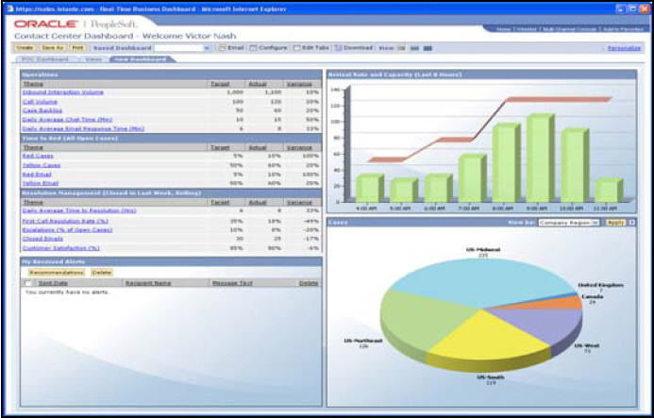
Bad Dashboards

Slide 5
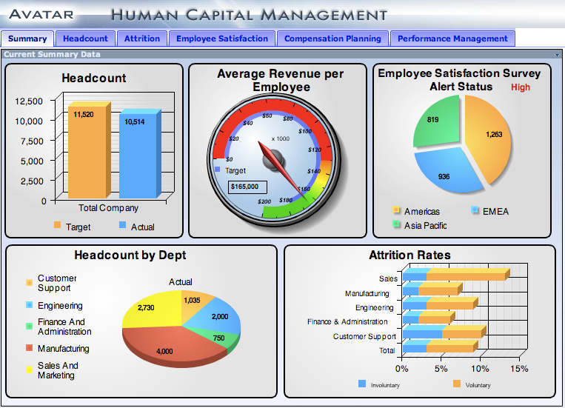
Bad Dashboards

Slide 6
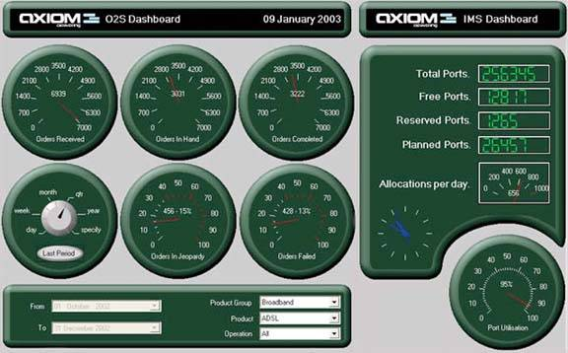
Bad Dashboards

Slide 7

So what IS a dashboard
Dashboards are reporting mechanisms that aggregate and display metrics and key performance indicators (KPIs), enabling them to be examined at a glance by all manner of users before further exploration via additional business analytics tools. Dashboards help improve decision making by revealing and communicating in-context insight into business performance, displaying KPIs or business metrics using intuitive means of visualization such as charts, dials, gauges and "traffic lights" that indicate progress toward defined targets.

Slide 8
So what IS a dashboard
Dashboards are reporting mechanisms that aggregate and display metrics and key performance indicators (KPIs), enabling them to be examined at a glance by all manner of users before further exploration via additional business analytics tools. Dashboards help improve decision making by revealing and communicating in-context insight into business performance, displaying KPIs or business metrics using intuitive means of visualization such as charts, dials, gauges and "traffic lights" that indicate progress toward defined targets.

Slide 9
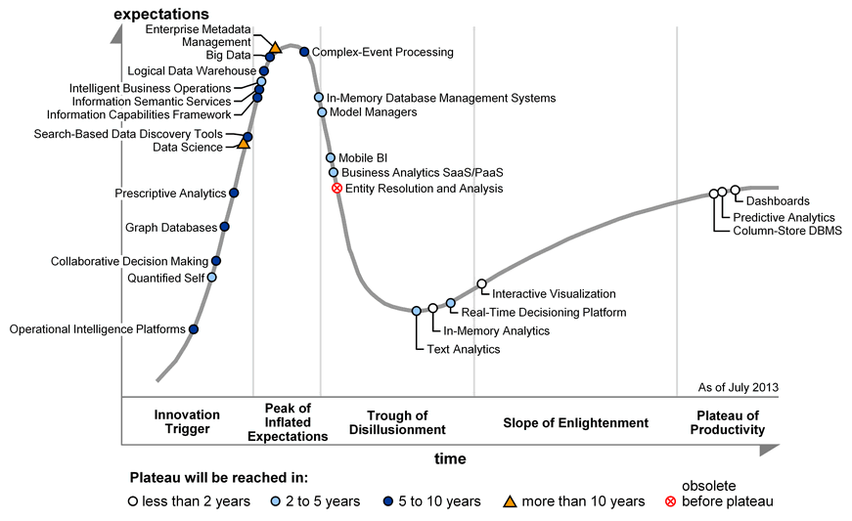

Slide 10
So WHAT IS a dashboard
A dashboard is a visual display
of
the most important information needed to achieve one or more objectives
that has been
consolidated on a single computer screen
so it can be
monitored at a glance
Stephen Few (Information Dashboard Design, p 26)

Slide 11
Visual Display
This means that
  They are graphical
  They should follow our principles of data visualization
  They are bound by the rules of visual perception

Slide 12
Specific Objective
This means that
  They are created for a purpose – usually one purpose
  They are created for an audience – usually one audience
  They pull together disparate information sources
  They are not limited to executives.

Slide 13
Specific Objective
Remember that a dashboard must be fit for purpose.
  Right information
  Right audience
  Right design

Slide 14
Specific Objective
Know your dashboard type
  Strategic/Executive
  Analytical
  Operational

Slide 15
Specific Objective
Strategic/Executive
  High level summary of past & current performance against benchmarks (KPIs)
  Usually not “live” data
    Snapshot of data
  Highly unstructured decision making
  Low use frequency
  Higher decision importance
  Longer decision impacts
  Longer decision horizons

Slide 16
Specific Objective
Analytical
  More interactive than strategic dashboard
  Drill-down to answer
    Who, what, where, when, why
  Focused on monitoring and managerial decision making
    Moderately unstructured decision making
  “Medium” decision importance
  “Medium” decision impacts
  “Medium” decision horizons

Slide 17
Specific Objective
Operational
  Departmental or business-process level data
  Short update cycle (or real time)
  High use frequency
  More structured decision making
  Daily or short decision horizons
  Shorter duration of decision impacts

Slide 18
Specific Objective
Before you start on a dashboard, you must know the purpose and audience.
  This will drive the type of dashboard that you build.

Slide 19
Single Screen
This means that
  They should fit entirely on one screen
    No scrolling
    No pages

Slide 20
At a Glance
This means that
  They are an overview.
  They should quickly point out when something is wrong.
  Does NOT need to provide all of the information necessary to take action
    Does drive to action

Slide 21
Shneiderman’s Mantra
Shneiderman’s mantra for analytical navigation
“Overview first,
Zoom and filter
Then details-on-demand.”
Readings in Information Visualization: Using Vision to Think, Stuart K. Card, Jock D. Mackinlay, and Ben Shneiderman, Academic Press, San Diego, California, 1999, page 625

Slide 22
Shneiderman’s Mantra
Overview First:
  Reduces search.
  Allows detection of overall patterns.
  Aids the user in choosing the next move.
Start with the “Big Picture”
  Not too much detail
  Allow users’ eyes to find points of interest
Readings in Information Visualization: Using Vision to Think, Stuart K. Card, Jock D. Mackinlay, and Ben Shneiderman, Academic Press, San Diego, California, 1999, page 625

Slide 23
Shneiderman’s Mantra
Zoom and Filter
  Analysis requires interaction with the data
  Allow for interaction once interesting items are observed
    Sorting
    Adding/Removing Variables
    Filtering
    Highlighting
    Aggregating/Disagregating
    Drilling
    Zooming/Panning
    Revisualizing
Notes:
Sorting. The act of sorting data, especially by the magnitude of the values from high to low or low to high, features the ranking relationship between those values and makes it easier to compare the magnitude of value to the next.
Adding/removing variables. You might need to view different variable at different times during the analysis process, so it is common to add or remove field of data from view as necessary
• Filtering. When you want to focus on a subset of data, nothing makes it easier to do so than filtering—the removal from view of everything your not interested in at the moment.
• Highlighting. Sometimes you want to focus on a subset of information, but do so in a way that allows you to maintain a sense of how that subset relates to the whole. Rather than filtering out the data that falls outside your range of focus, you can simply reduce its visual salience or increase the visual salience of the data you wish to focus on. This allows you to focus on the subset with less distraction from the whole in a way that allow you to remain aware of the whole. This is one way of achieving what’s called a focus+context view.
• Aggregating/Disaggregating. Analysis often requires that you examine data a different levels of detail. Aggregation involves viewing data at a higher level of summarization. Disaggregation involves viewing data at a lower level of detail.
• Drilling. Similar to disaggregation, drilling involves viewing data at a lower level of detail, but in a specific manner. Drilling also means that you are changing the view to the next level in a defined hierarchy, and excluding from view all data that is not directly related to the specific data value that you chose to drill into. For instance, if you drill into a particular product family, your next view only products that belong to that product family. In other words, a form of filtering is involved.
• Grouping. Sometimes it is useful to combine members of a variable together, treating them as a single member of the variable. This may take the form of combining some members and leaving others as they are, or of creating an entirely new variable that combines all members of an existing variable into a groups to form members of a higher level variable.
• Zooming/Panning. When a data visualization contains so much that it is difficult to clearly see all the data at once, it is useful to zoom in on that portion that you want to see more clearly. Panning involves moving around (for example, up, down, right, or left) in a zoomed view to focus on a different part of the larger visualization.
• Re-visualizing. No one visual representation of data can show you everything there is to see, so visual analysis involves shifting from one type of visualization to another to explore data from various perspectives.
• Re-expressing. Sometimes it is useful to express a quantitative variable as a different unit of measure, such as expressing dollars as percentages.
• Re-scaling. No single quantitative scale on a graph can serve every analytical need. Rescaling involves changing the range of the quantitative scale to make it easier to see particular patterns and sometimes even changing the nature of the scale, such as from a normal scale to a logarithmic scale.

Slide 24
Shneiderman’s Mantra
Details on Demand
  Provide as much detail as you can – when asked for it.
    Tool Tip in Tableau

Slide 25
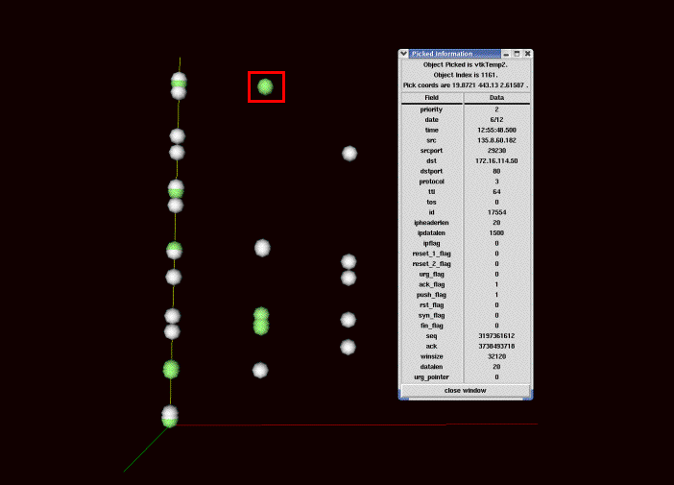

Slide 26
Successful Dashboards
Successful dashboards are:
  Customized to the user
  Focused on an overview that drives action – NOT the detail.
  Provide metrics – not data
Solution: MORE dashboards, not BIGGER dashboards.

